Slide 1
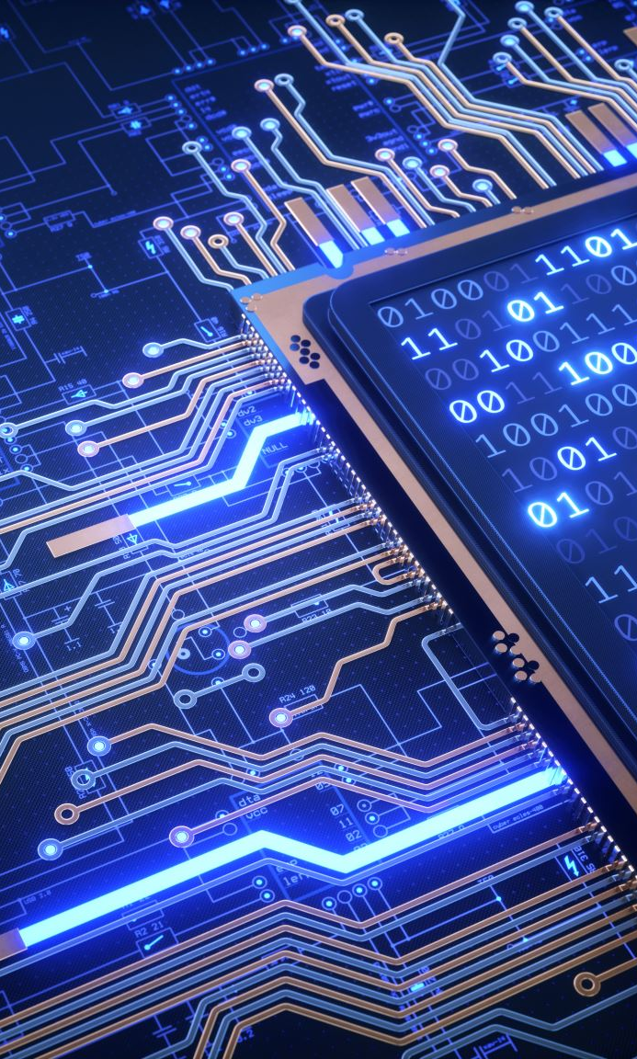
Unit III Architecture & Reference Model
Ms. Kritika Purohit
Assistant Professor
Computer Science & Engineering

Slide 2
Points to be covered-
Introduction to Architecture and Reference Model
URIs
Challenges in IoT
Design Challenges
Development Challenges
Security Challenges, and
Other Challenges

Slide 3
Introduction to Architecture and Reference Model
The first major contribution of the IoT Architectural Reference Model (IoT ARM) is the IoT Reference Model itself.
The IoT Reference Model provides the concepts and definitions on which IoT architectures can be built So, the purpose of an IoT Reference Model is to provide clear definitions and descriptions that can be applied accurately to elements and functions of IoT systems and applications.

Slide 4
This reference model:
Simplifies: It helps break down complex systems so that each part is more understandable.
Clarifies: It provides additional information to precisely identify levels of the IoT and to establish common terminology.
Identifies: It identifies where specific types of processing is optimized across different parts of the system.
Standardizes: It provides a first step in enabling vendors to create IoT products that work with each other.
Organizes: It makes the IoT real and approachable, instead of simply conceptual.

Slide 5
In an IoT system, data is generated by multiple kinds of devices, processed in different ways, transmitted to different locations, and acted upon by applications.
The proposed IoT reference model is comprised of seven levels. Each level is defined with terminology that can be standardized to create a globally accepted frame of reference.
The IoT Reference Model also allows the processing occurring at each level to range from trivial to complex, depending on the situation. The model describes how tasks at each level should be handled to maintain simplicity, allow high scalability, and ensure supportability. Finally, the model defines the functions required for an IoT system to be complete.

Slide 6
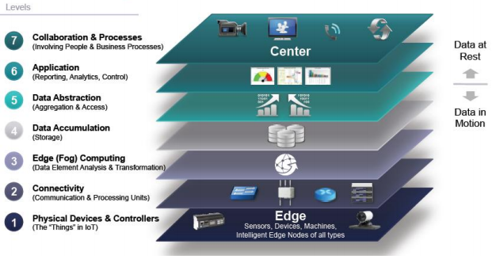

Slide 7
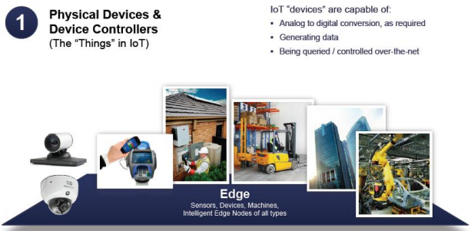
Level 1: Physical Devices and Controllers- The IoT Reference Model starts physical devices and controllers that might control multiple devices. These are the things in the IoT, and they include a wide range of endpoint devices that send and receive information.

Slide 8
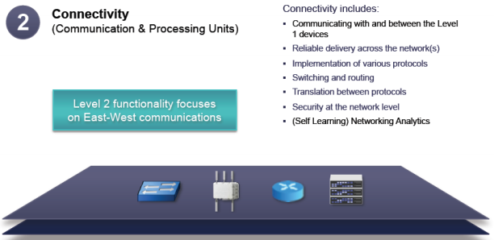
Level 2: Connectivity- Communications and connectivity are concentrated in one level. The most important function of Level 2 is reliable, timely information transmission. This includes transmissions:
Between devices (Level 1) and the network
Across networks (east-west)
Between the network (Level 2) and low-level information processing occurring at Level 3

Slide 9
Level 3: Edge (Fog) Computing- The functions of Level 3 are driven by the need to convert network data flows into information that is suitable for storage and higher level processing at Level 4 (data accumulation). This means that Level 3 activities focus on high-volume data analysis and transformation. Level 3 processing can encompass many examples, such as:
Evaluation
Formatting
Expanding/decoding
Distillation/reduction
Assessment

Slide 11
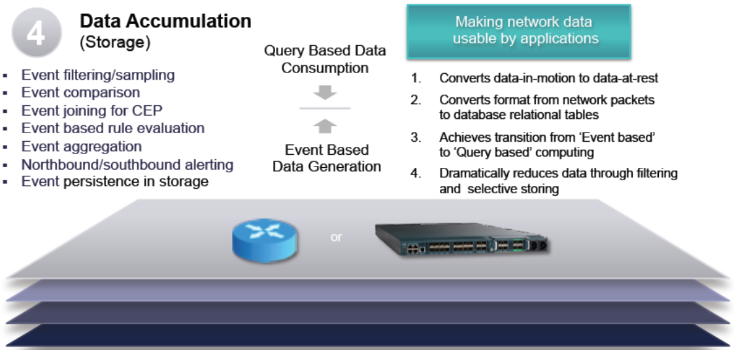
Level 4: Data Accumulation- Networking systems are built to reliably move data. The data is in motion. prior to Level 4, data is moving through the network at the rate and organization determined by the devices generating the data. The model is event driven. Level 4 converts event-based data to query-based processing. This is a crucial step in bridging the differences between the real-time networking world and the non-real-time application world.

Slide 13
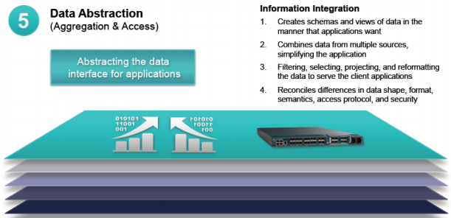
Level 5: Data Abstraction- IoT systems will need to scale to a corporate or even global level and will require multiple storage systems to accommodate IoT device data and data from traditional enterprise ERP, HRMS, CRM, and other systems. The data abstraction functions of Level 5 are focused on rendering data and its storage in ways that enable developing simpler, performance-enhanced applications.

Slide 14
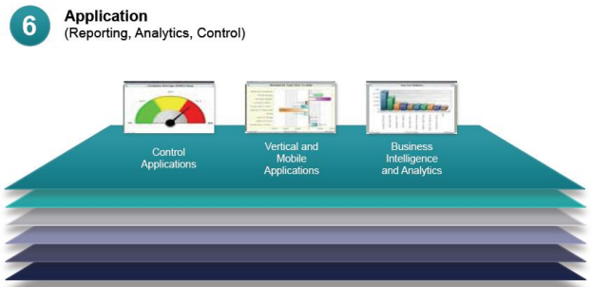
Level 6: Application- Level 6 is the application level, where information interpretation occurs. Software at this level interacts with Level 5 and data at rest, so it does not have to operate at network speeds. The IoT Reference Model does not strictly define an application. Applications vary based on vertical markets, the nature of device data, and business needs.

Slide 15
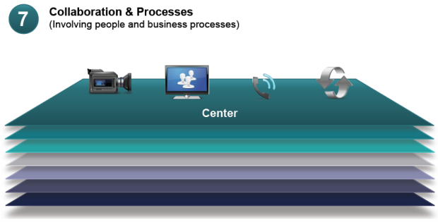
Level 7: Collaboration and Processes- The IoT system, and the information it creates, is of little value unless it yields action, which often requires people and processes. Applications execute business logic to empower people. People use applications and associated data for their specific needs. Often, multiple people use the same application for a range of different purposes. So, the objective is not the application—it is to empower people to do their work better.

Slide 16
Security in the IoT- Discussions of security for each level and for the movement of data between levels could fill a multitude of papers. For the purpose of the IoT Reference Model, security measures must:
Secure each device or system
Provide security for all processes at each level
Secure movement and communication between each level, whether north- or southbound

Slide 17
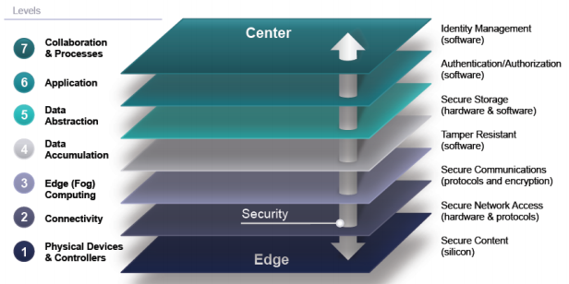

Slide 18
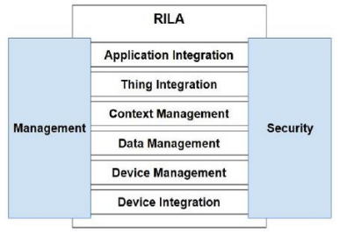
Reference IoT Layered Architecture-
RILA consists of 6 layers. Besides these layers there are two cross-section-layers that affect all other layers, namely Security and Management.

Slide 19
Device Integration Layer- This layer connects all the different device types and consumes device measurements as well as it communicates actions (on device level). This layer can be seen as a translator that speaks many languages.

Slide 20
Device management Layer- This is in charge of taking device registrations and sensor-measurements from the device integration layer. Furthermore it communicates status changes for actuators down to the device integration layer. The device integration layer then just validates that the status change (i.e. the action) is confirm with the actuator and then translates the status change to the actuator.

Slide 21
Data management Layer- It can be seen as a central database that holds all data of a thing, but this is only one possible implementation. For larger things within the system (e.g. a device life-cycle monitoring system collecting data from other things) data management might be a data warehouse or even a complete data farm. The implementation of the data management layer thus strongly depends on the use-case for the specific thing.

Slide 22
Context management Layer- It defines the central business logic within RILA and is responsible for six tasks:
1. Define the goals of the thing.
2. Consume the context situation(s) of other things
3. Produce the (own) context situation of the thing.
4. Evaluate the (own) context situation towards the goal.
5. Trigger actions that help to fulfil the goal according to the evaluated rules.
6. Publish context situations for other things.

Slide 24
Thing integration layer - This layer is responsible for finding other things and communicating with them. Once two things found each other they have to undergo a registration mechanism. The thing integration layer has to evaluate if the communication with the thing to be partnered with is possible. For this purpose the context situation and/or action schemata have to be compared.

Slide 25
Application integration layer- This layer connects the user to the thing. Applications that are (directly) on top of the RILA architecture are located here. The application integration can be seen as a service layer, or even as a simple UI on top of the stack. The concrete implementation of the layer depends on the use case.

Slide 26
When building an IoT system we have to consider security on all layers. Attack vectors have to be identified in order to identify appropriate security standards.

Slide 27
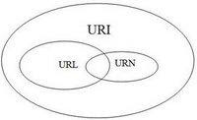
Uniform Resource Identifier
A URI (Uniform Resource Identifier) is a sequence of characters that identifies a logical or physical resource. Universal Resource Identifiers are specified in the Internet Engineering Task Force (IETF) Request for Comments (RFC) 3986 and are summarized and extended in documentation for the W3C’s Web Architecture, Architecture of the World Wide Web, Volume.
Every URL is also a URI, but not vice versa.
There are two types of URIs-
Uniform Resource Locator (URL),
Uniform Resource Names (URN)

Slide 28
Uniform Resource Locator- It is a subset of the Uniform Resource Identifier (URI) that specifies where an identified resource is available and the mechanism for retrieving it. A URL defines how the resource can be obtained. This type of URI begins by stating which protocol should be used to locate and access the physical or logical resource on a network. If the resource is a web page.
Example:- The URI will begin with the protocol HTTP. If the resource is a file, the URI will begin with the protocol FTP or if the resource is an email address, the URI will begin with the protocol mailto.
It is important to remember that URLs are not persistent. This means that if the resource’s location changes, the URL also needs to change to point to the resource’s new location.

Slide 29
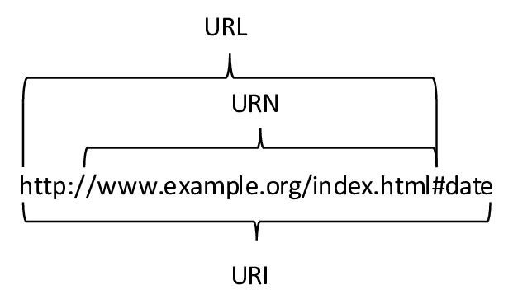
Uniform Resource Name- This type of URI does not state which protocol should be used to locate and access the resource; it simply labels the resource with a persistent, location-independent unique identifier. A URN will identify the resource throughout its lifecycle and will never change. Each URN has three components: the label “urn,” a colon and a character string that serves as a unique identifier. URN is completely different than URL as it doesn't include any protocol.
Examples:- ISBN number, which is used to uniquely identify a book.

Slide 30
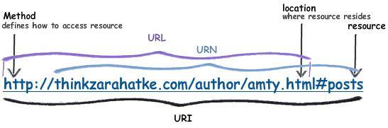

Slide 31
URI Syntax - The generic form of any URI is-
scheme:[//[user:password@]host[:port]][/]path[?query][#fragment]
Scheme: The scheme lays out the concrete syntax and any associated protocols for the URI. Schemes are case-insensitive and are followed by a colon.
Authority component: An authority component is made up of multiple parts: an optional authentication section, a host -consisting of either a registered name or an IP address -- and an optional port number. The authentication section contains the username and password, which are separated by a colon and followed by the symbol for at (@). After the @ comes the hostname, which is in turn followed by a colon and then a port number. It is important to note that IPv4 addresses must be in dot-decimal notation, and IPv6 addresses must be enclosed in brackets.
The path, which contains data, is notated by a sequence of segments separated by slashes.

Slide 32
Query (optional): The query contains a string of nonhierarchical data. Although the syntax is not well-defined, it is most often a sequence of attribute value pairs separated by a delimiter, such as an ampersand or a semicolon. The query is separated from the preceding part by a question mark.
Fragment (optional): The fragment contains a fragment identifier that provides direction to a secondary resource. For example, if the primary resource is an HTML document, the fragment is often an ID attribute of a specific element of that document. If the fragment identifies a certain section of an article identified by the rest of the URI, a Web browser will scroll this particular element into view. The fragment is separated from the preceding part by a hash (#).

Slide 33
URI resolution and references-
URI resolution is one of a few common operations performed on URIs that are also URLs. It involves determining the proper data access method and parameters needed to locate and retrieve the resource that the URI points to.
A URI-reference is used to determine common usage for a URI. A URI reference may take the form of a full URI, a specific portion of a full URI or an empty string. If there is a fragment identifier, it will identify some portion of the resource referred to by the rest of the URI. A URI-reference can be a URI, but it can also be what is known as a relative reference. A URI is a relative reference if the URI-reference's prefix does not match the syntax of a scheme followed by its colon separator. In order to determine what components are present and whether the reference is relative, each of the five URI components are parsed for its subparts and their validation.

Slide 34
Use the URI Data Type in Device Models- The URI (Uniform Resource Identifier) data type helps store pointers or references to external content.
If you have devices that need to support large content in messages, such as camera images and videos from facilities monitoring data, you can use the URI data type in your device model attributes. The URI data type lets you store pointers to your content, which can be stored in an external location, such as Oracle Storage Cloud Service or Oracle Documents Cloud Service.
Use the URI data type for device model attributes, action arguments, and format field types that must point to external content.

Slide 35
Challenges in IoT
IoT brought users huge benefits; however, some challenges come along with it. Cybersecurity and privacy risks are the primary concerns of the researchers and security specialists cited.
These two are posing a considerable predicament for many business organizations as well as public organizations. Prevalent high-profile cybersecurity attacks have demonstrated the vulnerabilities of IoT technologies. This vulnerability is simply because the interconnectivity of networks in the Internet of Things brings along accessibility from anonymous and untrusted Internet requiring novel security solutions.
Of all the challenges that are known, none of them has a more significant influence on IoT adaptation, such as security and privacy.

Slide 36
IoT Security Challenge- Over the years, the number of devices connected to the Internet has increased exponentially. From a little over 15 billion devices in 2015, over 23 billion devices are connected in 2018. It is estimated that the figure will exceed the 30 billion mark by 2020 and over 75 billion devices are expected to be connected to the Internet by 2025.

Slide 37
The IoT is diverse from traditional computers and computing devices, makes it more vulnerable to security challenges in different ways:-
Many devices in the Internet of Things are designed for deployment on a massive scale. An excellent example of this is sensors.
Usually, the deployment of IoT comprises of a set of alike or nearly identical appliances that bear similar characteristics. This similarity amplifies the magnitude of any vulnerability in the security that may significantly affect many of them.
IoT Agenda defines IoT security as The technology area concerned with safeguarding connected devices and networks in the Internet of Things (IoT). Simply put, IoT security refers to the precautionary measures taken to beef up the security of IoT devices and reduce their susceptibility to attacks from unauthorized criminals.

Slide 38
Five proven solutions that you may implement to increase the security of an IoT devices are:
Use IoT Security Analytics- The vulnerabilities and security issues associated with IoT can be drastically reduced by implementing security analytics. This involves collecting, correlating, and analyzing data from multiple sources that can assist IoT security providers to identify potential threats and nip such threat in the bud.
Use Public Key Infrastructure- The Public Key Infrastructure is a set of policies, software/hardware, and procedures, which is required for the creation, management, and distribution of the digital certificates. This security process has proven over the years to be an effective solution to IoT security issues. Security measure involves using digital certificates for verifying the identity of all the devices connected together in an IoT. It also maintains the privacy of information to keep it away from the reach of potential attackers.

Slide 39
Ensure Communication Protection- The IoT concept works on communication between the connected devices. However, when communication is compromised, there will be a communication breakdown that can render the devices useless.
Secure the Network- IoT devices are connected to back-end systems that are already connected to the Internet via an IoT network. This network plays a crucial role in the smooth operation of IoT devices. To sustain the smooth operation, there is a need for the IoT network to be protected and secured. By employing some endpoint security features like anti-malware, antivirus, intrusion prevention, and firewalls, you can effectively protect the network and secure it against attacks.
Ensure Device Authentication- You can also reduce your IoT devices‘ vulnerability to attacks if you carry out a comprehensive device authentication for your devices.

Slide 40
Design Challenges- The Internet of Things offers significant potential for societies to improve the way they live and interact with each other. Businesses can gather essential information to streamline their operations, predict major changes, and ensure they‘re meeting customer expectations in real-time. Consumers benefit from being able to live intelligently rather than continuously focusing on mundane tasks. Although the technology has numerous positive benefits, there are a few unique challenges developers need to tackle when they‘re building out IoT systems.
Challenge 1: Battery Life is a Limitation
Challenge 2: Managing Data
Challenge 3: Emerging Standards
Challenge 4: Designing for Everyone

Slide 41
Development Challenges- Four Challenges to be Considered When Developing IoT Devices.
Connectivity- Connectivity is the first concerning issue, i.e., how to connect devices to the Internet and the cloud computing platform. However, to a great extent, this is determined by the device application environment and the type of communication infrastructure provided to these devices.
Security and Privacy- IoT security has always been a controversial issue. The following lists some key points for security design that are considerable:
Physical Security- Tamperproof or secure hardware
Security of Data Exchange- Secure transfer protocols
Security of Cloud Storage- Encrypted data with proper access controls
Update- Update Information of Apps on Air if required

Slide 42
Flexibility and Compatibility- As the IoT pattern is continuously changing, we must ensure that our product can support future technologies. However, it requires us to balance between software and hardware when designing our product.
Data Collection and Processing- In addition to security and privacy, we must also properly plan how to process all collected data. We must first evaluate the amount of processed and collected data to control the size of our cloud storage and meet our platform requirements. IoT data can complete multiple practical functions, including:
Supplement Existing Data- Use of Existing data
Analyze and Further Divide Users- Analyze data to identify user preferences
Find Opportunities to Improve Products- Analyze data for future products

Slide 43
Other Challenges-
Reliability- When the power goes out, or the local internet service provider is experiencing an outage, entire systems go offline. Natural disasters or emergencies can also affect data centers, which most IoT solutions require to operate adequately.
Solution: Low-power and offline support are certainly two features that should be prioritized for the Internet of Things market. However, in the commercial world, there needs to be a reliable way to utilize devices and systems under unexpected conditions.
Resource Consumption- Electronics require energy to operate and IoT devices are no exception. Worse yet, they must actively transmit data 24/7, which means support from other technologies, including network adapters, gateways and more.
Solution: As technology advances, it generally becomes more efficient about resource consumption. Installing a renewable energy source like a solar power system at resource-intensive locations is a great example.

Slide 44
Fragmentation- The IoT world consists of thousands of devices from as many brands and developers. Each one is designed to work on a proprietary ecosystem, with separate mobile apps, tools and gateways to support them. The fragmentation is incredible, and it‘s something that could truly hold back the industrial world. It could prove disastrous in certain industries, like the medical sector, where it‘s necessary to have clearly-defined and ultra-reliable solutions in place.
Solution: There needs to be open standards, especially for IoT applications and devices. They should exist to unify the communication and usability of all devices, namely when it comes to data usage.

